Slide 1
C Programming Language
https://sourceforge.net/projects/mingw/postdownload
Mother of All Language

Slide 2
C Introduction and Installation
C is a middle level programming language which was developed in 1972s at Bell Laboratories by Dennis Ritchie.
It has the Concept of High Level Language as well as power of Low Level Language.The Whole "UNIX" operting System is designed using C programming Language.
"C" programming language was derived from "B" Language and the "B" language was derived from BCPL (Basic Combined Progamming Language)

Slide 3
Base Level Programming
Machine Level Programming Language
Middle level
High Level

Slide 4
C Installation (Turbo C++)
https://developerinsider.co/download-turbo-c-for-windows-7-8-8-1-and-windows-10-32-64-bit-full-screen/
Turbo c++ install

Slide 5
C Installation
VS Code
MinGW (MinGW - Minimalist GNU for Windows)
MinGW: A native Windows port of the GNU Compiler Collection (GCC), with freely distributable import libraries and header files for building native Windows applications; includes extensions to the MSVC runtime to support C99 functionality. All of MinGW's software will execute on the 64bit Windows platforms.

Slide 6
Creation of C program consists of three steps
1.Creation of Program
2. Compilation of Program
----(High Level Language) convert Binery/Low level Language
3. Execution of Program

Slide 7
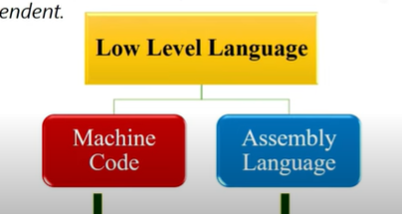
Low Level Language
A Low Level Language is Programming language that provides little or no abstraction from of Computer instruction. A low level Language is Machine Dependent
(Machine code -Binary )
Assembly -CPU register

Slide 8
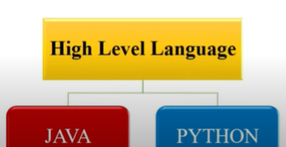
High Level Language

Slide 9
Low Level Language Vs High Level Language
Hard to UnderStand (LLL)
Easy to Understand(HLL)
complex to modify(LLL)
Easy to Modify(HLL)
Complex to maintain(LLL)
Easy to maintain(HLL)
Complex to debug(LLL)
Easy to debug(HLL)
Machine Dependent(LLL)
Machine Independent(HLL)

Slide 10
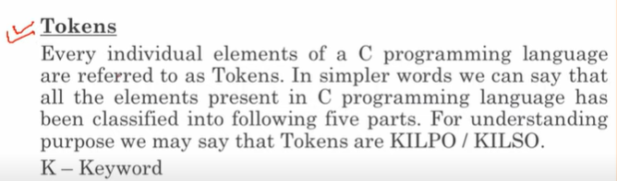
Tokens

Slide 11
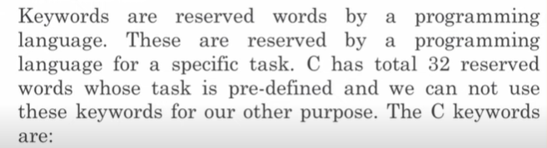
KeyWords (

Slide 12
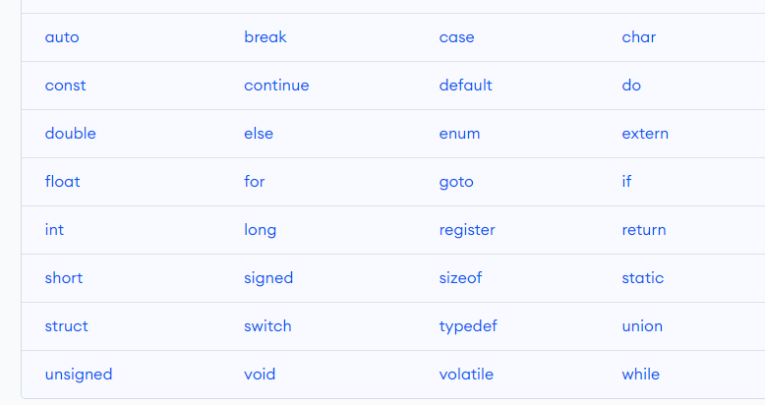

Slide 13
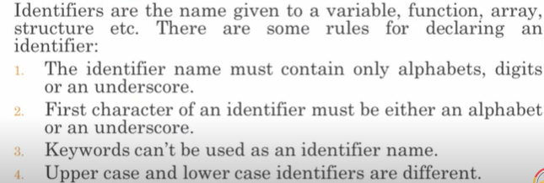
Identifiers

Slide 14
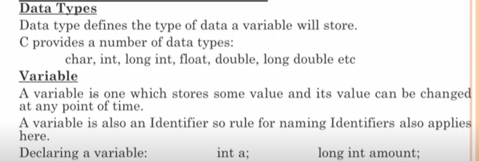
Variables and Constants in C

Slide 15
data type
int a; long int amount;
int a,b,c float a,b,c
int a;
a =5;
float b;
b =50.5;
char c;
c =”helo”

Slide 16
Constants in C
int a =5;
a =12;
const int a =20;
a =40; x----xxxx
const float b =5.5

Slide 17
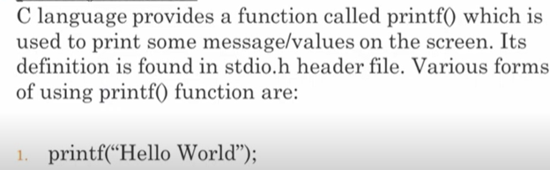
Printf Function in C (stdio.h) standard input output

Slide 18
Conversion Specification( %) printf and scanf
%d -for printing/redaing integer values
%ld -for printing/redaing long integer values
%f - for printing/redaing decimal values
%c - for printing/redaing character values
%s - for printing/redaing string values
int a =5;
printf(“%d”,a); //conversion specification(ye khud ko a ke sath convert karege)
output :5
---------------------------
float p =3.5;
printf(“%f”,p)
output :3.5
----

Slide 19
Scanf function in C (input user)
int main()
{
int a;
printf("Enter a Number");
scanf("%d",&a); //screen fold //read input value
printf("Value of a =%d",a);
}

Slide 20
First C Program
#include<stdio.h> ---Preprocessor Statement
stdio.h --standard input output (header file )
//bahut se function hote hai jis ko hum use karte hai...
printf() function
scanf() function

Slide 21
Operators
Arithmetic Operators
Relational Operators
Logical Operators
Bitwise Operators
Assignment Operators

Slide 22
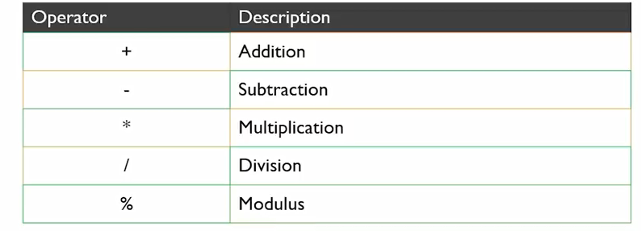
Arithmetic Operators

Slide 23
Assignment Operators
+=
-=
%=
/=

Slide 24
Unary operators
Unary operators are the operators that perform operations on a single operand to produce a new value.
Types of unary operators
Types of unary operators are mentioned below:
Unary minus ( – )
Increment ( ++ )
Decrement ( — )
NOT ( ! )
Addressof operator ( & )
sizeof()

Slide 25
Unary Minus
The minus operator ( – ) changes the sign of its argument. A positive number becomes negative, and a negative number becomes positive.
Int a =10
Int b =-a //b =-10

Slide 26
Addressof operator ( & )
The addressof operator ( & ) gives an address of a variable. It is used to return the memory address of a variable. These addresses returned by the address-of operator are known as pointers because they “point” to the variable in memory.

Slide 27
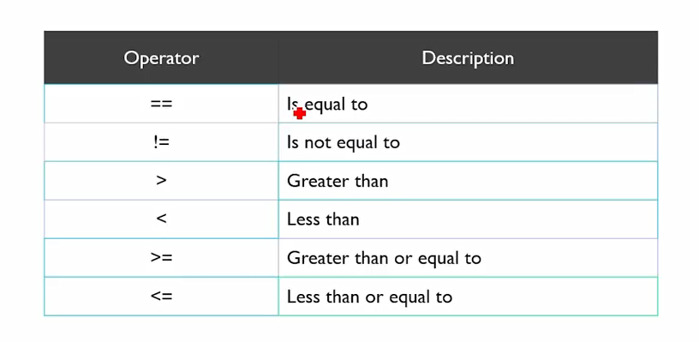
Relational Operators(Comparison)

Slide 28
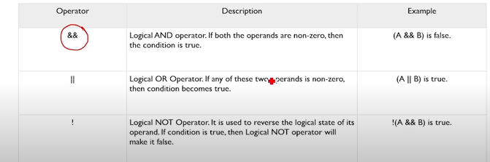
Logical Operators

Slide 29
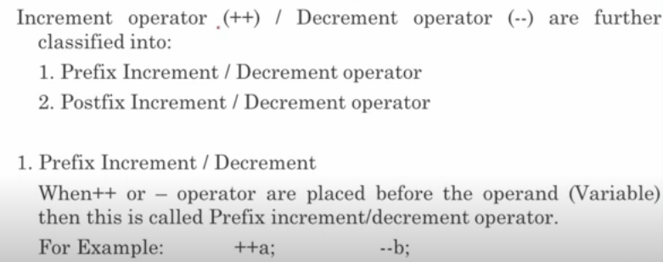
Increment Decrement in C Programming

Slide 30
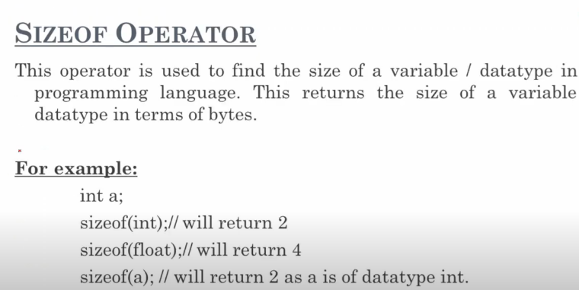
Sizeof Operator

Slide 31
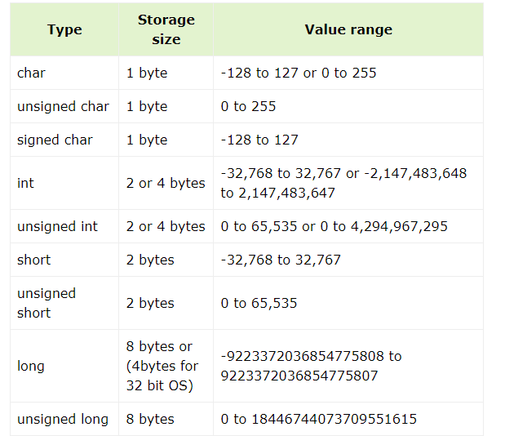

Slide 32
Ternary / Conditional Operator in C Programming

Slide 33
C Program to convert temperature from Fahrenheit to Celsius

Slide 34
Control Statements - If | Loops
Selection Statement:
1.if…else
2.switch
3.goto
Looping Statement:
1.while
2.do…while
3.for

Slide 35
Int a,b;
a =10, b =30;
If(a>b){ //true
Printf(“yes”)
}else{
Printf(“no”)
}

Slide 36
If….else Statement
Syntax:
if(condition)
Statement;
Else
statement;

Slide 37
C if...else Ladder
if (test expression1) {
// statement(s)
}
else if(test expression2) {
// statement(s)
}
else if (test expression3) {
// statement(s)
}
.
.
else {
// statement(s)
}

Slide 38
Int a =10 b =20 c =30
If(a>b && b >c)
Print(“yes”)
Else if(b>c)
Print(“yes”)
Else if(a>c)
Print(“yes”)
Else{
Print(“no”)
}

Slide 39
Nested if...else
It is possible to include an if...else statement inside the body of another if...else statement.

Slide 40
Switch Case Control Statements
switch(expression)
{
case value1: statement_1;
break;
case value2: statement_2;
break;
.
.
.
case value_n: statement_n;
break;
default: default_statement;
}

Slide 41
Loops in c (While Loop)
While loop does not depend upon the number of iterations. In for loop the number of iterations was previously known to us but in the While loop, the execution is terminated on the basis of the test condition. If the test condition will become false then it will break from the while loop else body will be executed.
initialization_expression;
while (test_expression)
{
// body of the while loop
update_expression;
}

Slide 42
Do While Loop
The do-while loop is similar to a while loop but the only difference lies in the do-while loop test condition which is tested at the end of the body. In the do-while loop, the loop body will execute at least once irrespective of the test condition.
initialization_expression;
do
{
// body of do-while loop
update_expression;
} while (test_expression);

Slide 43
for Loop
for (initialize expression; test expression; update expression)
{
//
// body of for loop
//
}
for(int i = 0; i < n; ++i)
{
printf("Body of for loop which will execute till n");
}

Slide 44
Break and Continue Statements In C:

Slide 45
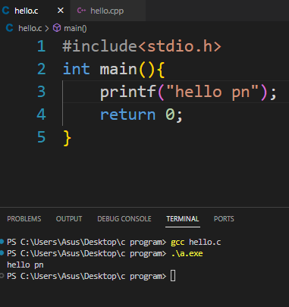
Hello.c (gcc )GNU compliler Collection

Slide 46
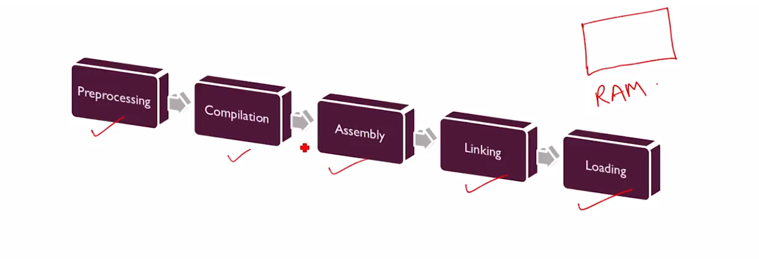

Slide 47
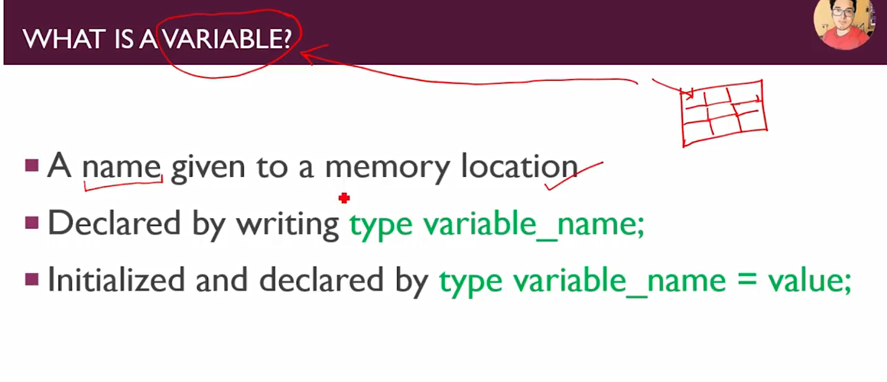
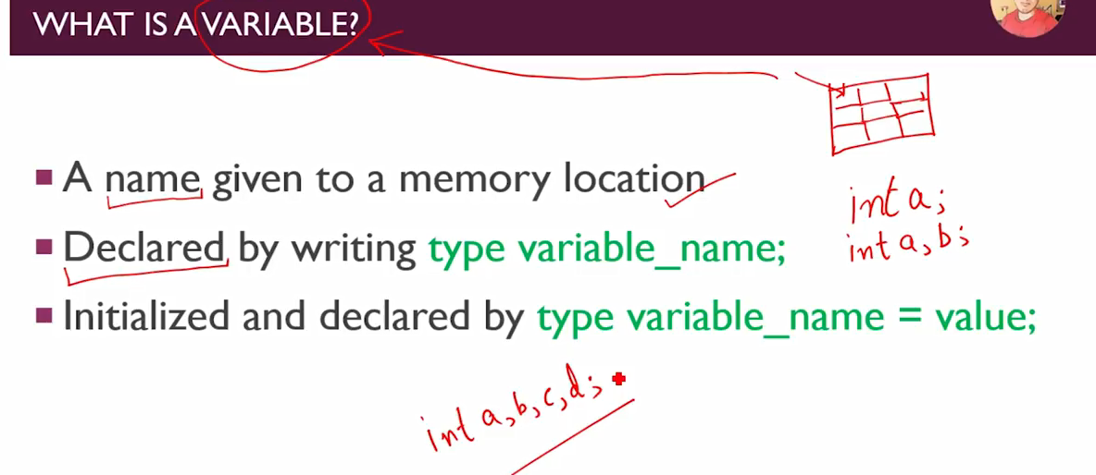
Variables (memory_location ko diya gaya name)

Slide 48
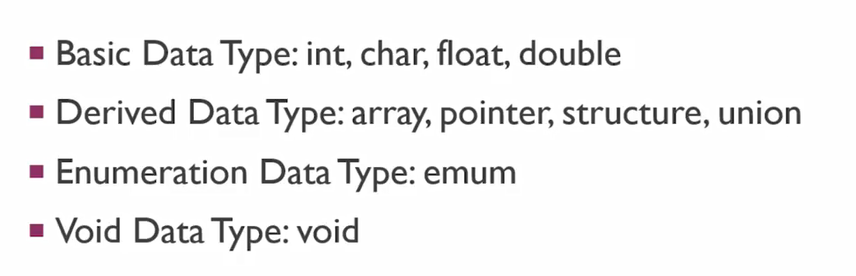
Variables & Data Types in c void (kuch nahi khali)bolte hai

Slide 49
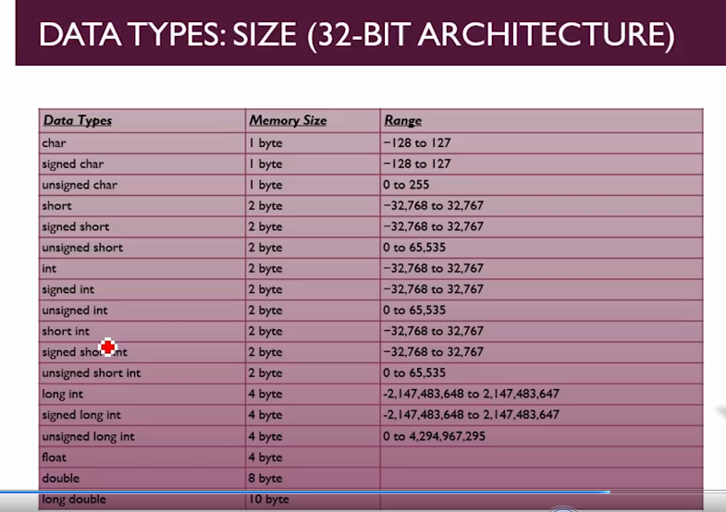

Slide 50
